Slide 1
Minting Children

Slide 2
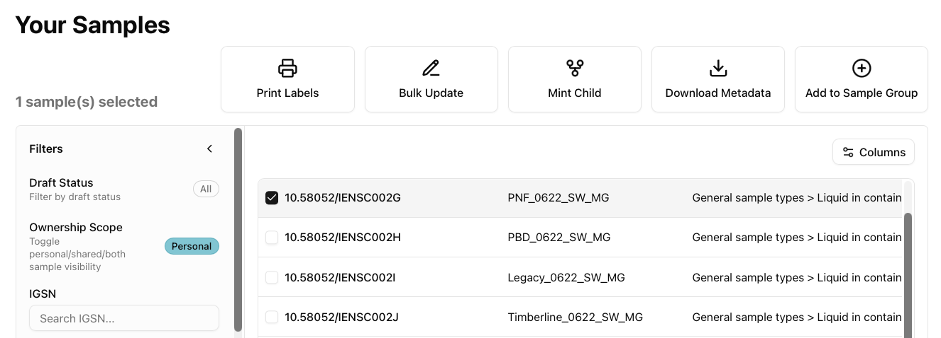
Mint Children Samples
Select the sample you want to mint a child.
You can only choose one sample at a time.

Slide 3
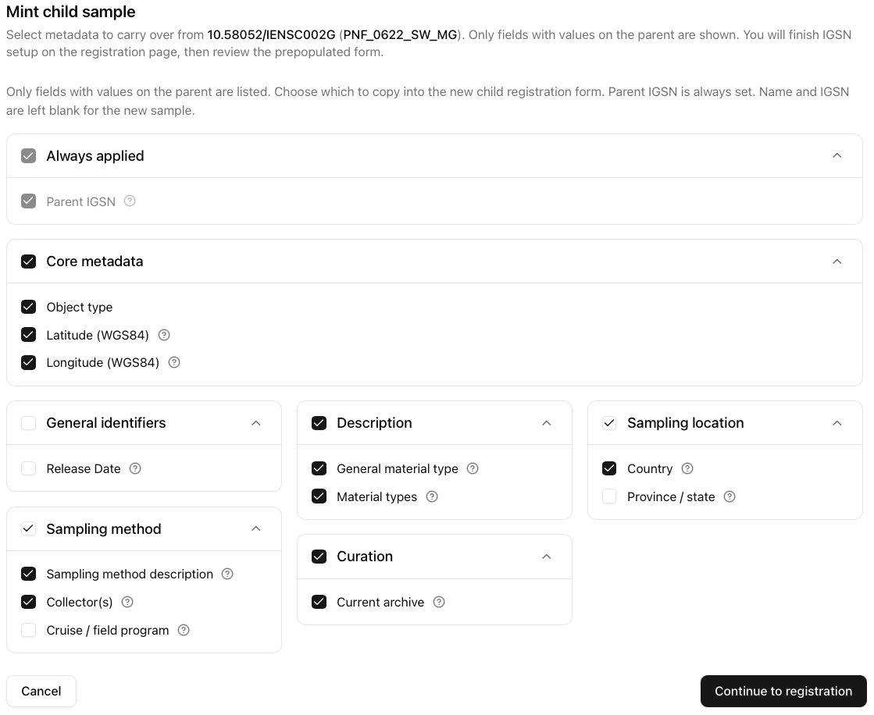
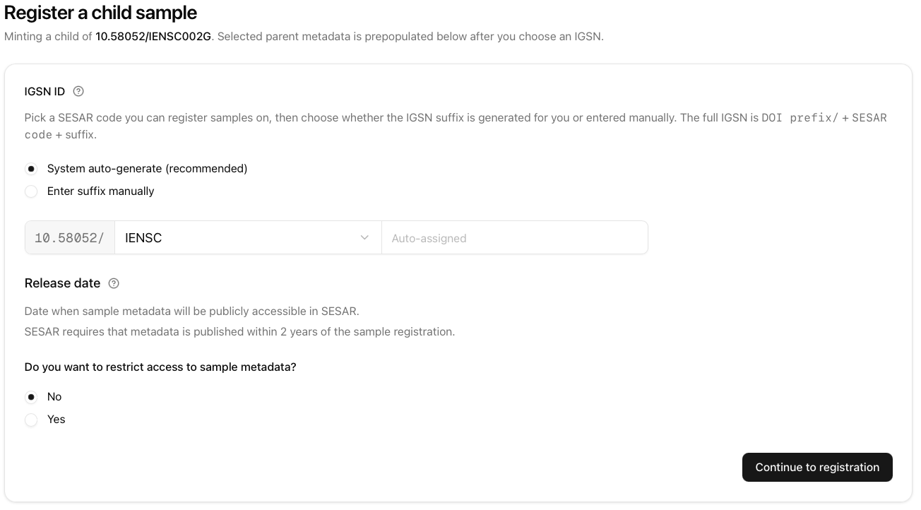
Mint Children Samples
Follow the steps for registration.
This is the same as an individual sample registration.
The mint child sample form will automatically copy over existing metadata from the parent sample. Uncheck those that are not needed.

Slide 4
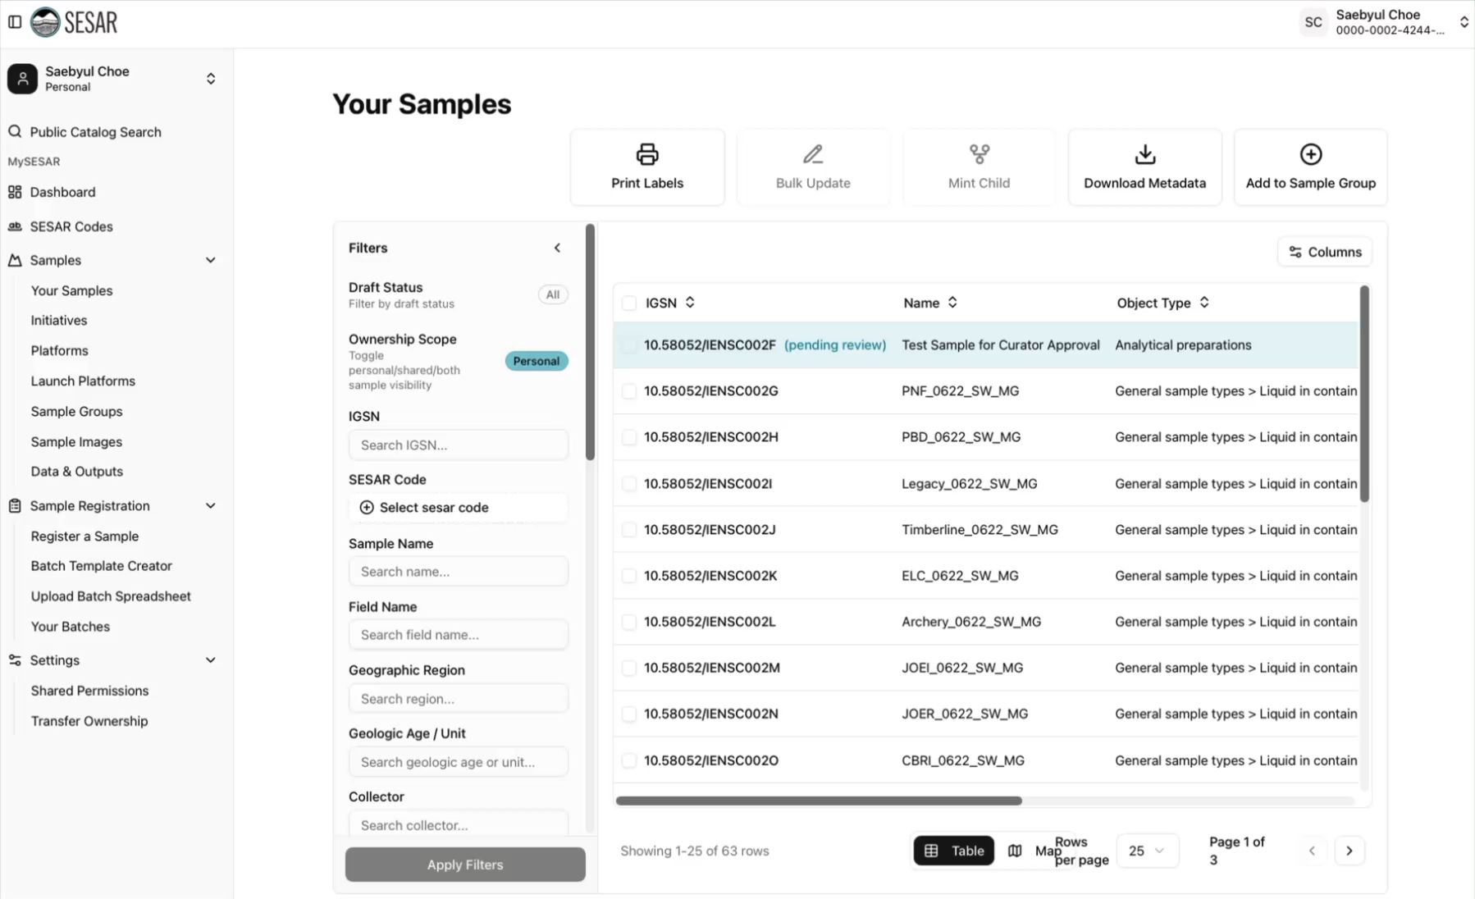
VIDEO Tutorial

